Slide 1
Object Detection
By Yaohang Li, Ph.D. Department of Computer Science Old Dominion University yaohang@cs.odu.edu
Some slides and figures are from
A Gentle Introduction to Object Recognition with Deep Learning by Jason Brownlee
Object detection with neural networks — a simple tutorial using keras by Johannes Rieke

Slide 2
Agenda
From Image Classification to Object Localization to Object Detection
A Simple Introduction to Object Detection
State-of-the-Art Object Detection Methods
R-CNN
YOLO
Applications of Object Detection
Summary

Slide 3
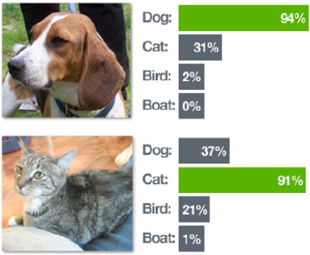
Image Classification
Image Classification
Predict the type or class of an object in an image
Input
An image with a single object
Output
A class label

Slide 4
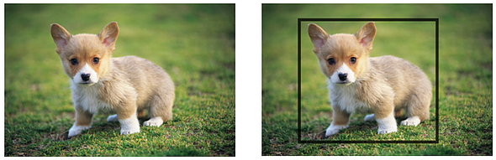
Object Localization
Object Localization
Locate the presence of objects in an image and indicate their location with a bounding box
Input
An image with one or more objects
Output
One or more bounding boxes (a point, width, and height)

Slide 5
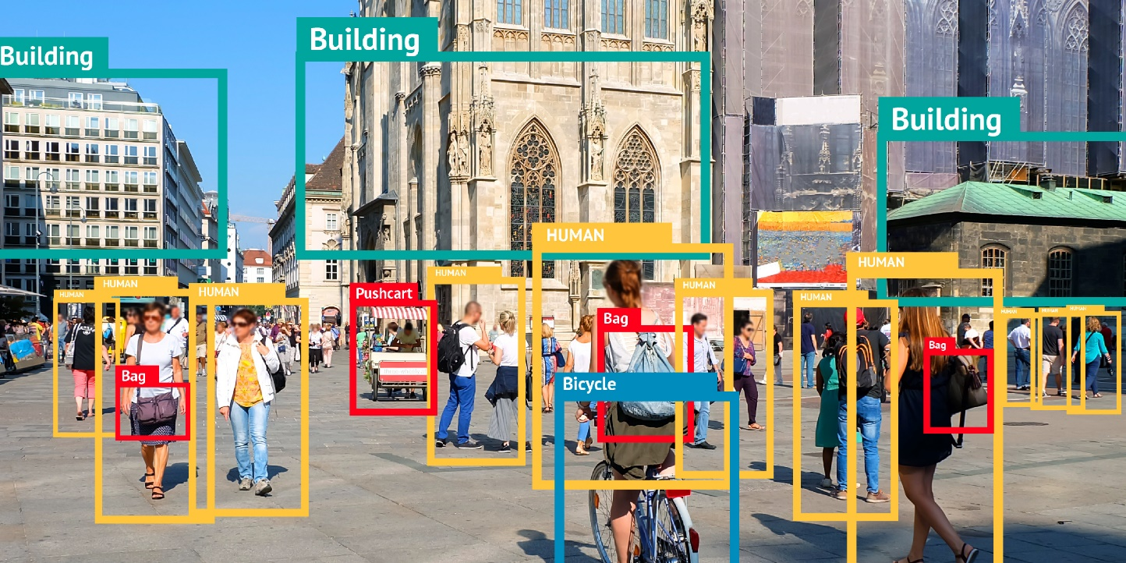
Object Detection
Object Detection
Locate the presence of objects with a bounding box
Identify the classes of the located objects
Input
An image with one or more objects
Output
One or more bounding boxes
A class label for each bounding box

Slide 6
Image Classification, Object Localization, and Object Detection

Slide 7
Image Classification, Object Localization, and Object Detection

Slide 8
Agenda
From Image Classification to Object Localization to Object Detection
A Simple Introduction to Object Detection
State-of-the-Art Object Detection Methods
R-CNN
YOLO
Applications of Object Detection
Summary

Slide 9
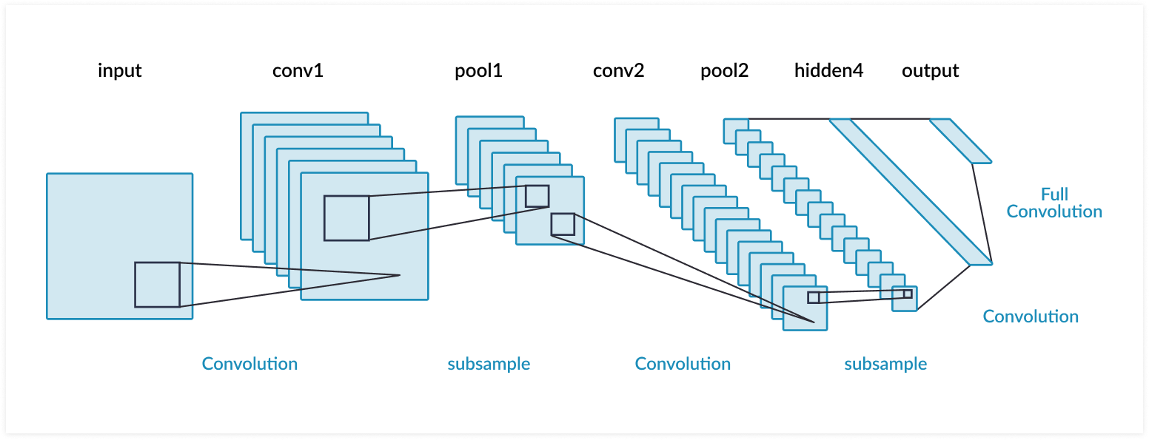
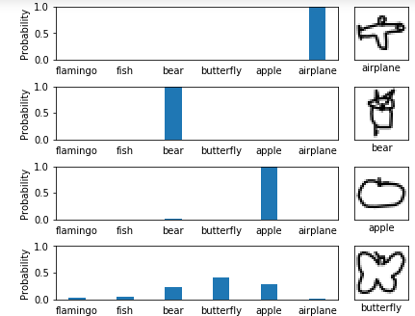
Image Classification
Predict the classes of objects present in an image

Slide 10
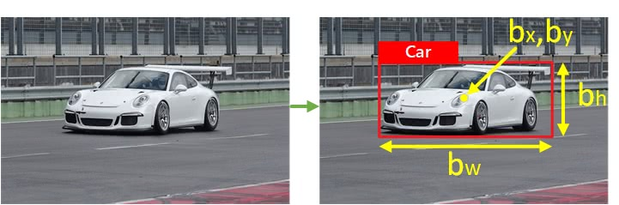
Bounding Box
Draw a bounding box around one example of each object present in an image
Box: (b_{x}, b_{y}, b_{h}, b_{w})

Slide 11
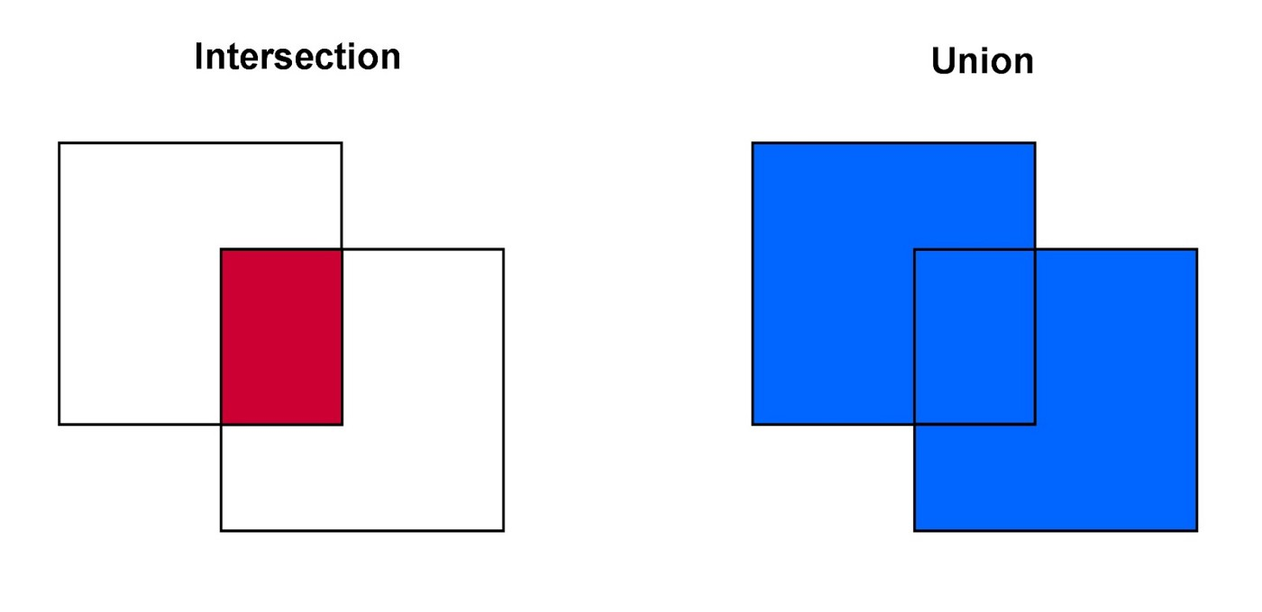
IOU Metric
Intersection Over Union (IOU) Metric
Intersection/Union
Max: 1 (perfect match)
Min: 0 (no match)

Slide 12
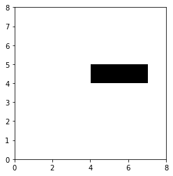
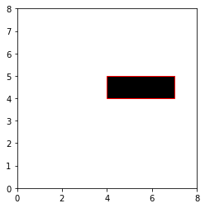
Single Object Localization
Input
Image
Output
(b_{x}, b_{y}, b_{h}, b_{w})
Evaluation Metric
IOU
0.95

Slide 13
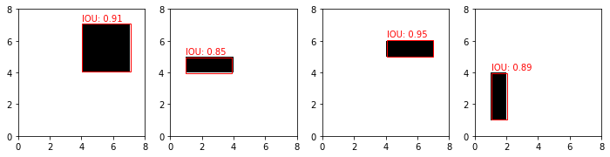
Demo: Single Object Localization
Jupyter notebook rectangle_detection.ipynb

Slide 14
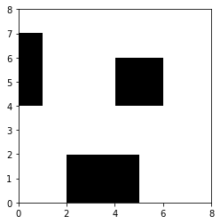
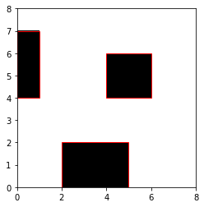
Multiple Objects Detection
Input
Image
Output
(bx₁, by₁, bh₁, bw₁)
(bx₂, by₂, bh₂, bw₂)
…
Evaluation Metric
Sum of IOUs

Slide 15
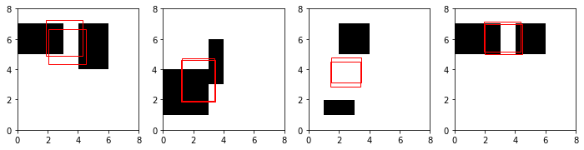
Order Problem of Multiple Object Localization
The Order Problem
Training label
(bx₁=5, by₁=4, bh₁=1, bw₁=2)
(bx₂=1, by₂=3, bh₂=4, bw₂=1)
Predicted label
(bx₁=5, by₁=4, bh₁=1, bw₁=2)
(bx₂=1, by₂=3, bh₂=4, bw₂=1)
What about the following predicted label?
(bx₁=1, by₁=3, bh₁=4, bw₁=1)
(bx₂=5, by₂=4, bh₂=1, bw₂=2)
Perfect, IOU = 1.0
Still correct, but IOU = 0.0

Slide 16
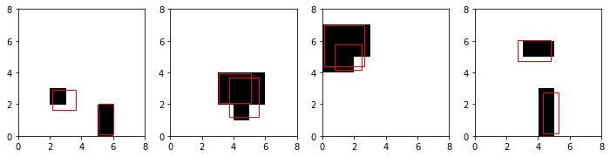
Solution to the Order Problem
Adjust the Loss
Flip the predicted bounding boxes if it leads to smaller IOU error
Training Model without Flipping
Training Model with Flipping

Slide 17
Demo: Localizing Two Rectangles
Jupyter notebook two_rectangles.ipynb

Slide 18
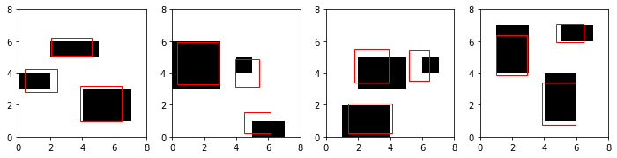
Demo: Localizing Three Rectangles
Jupyter notebook multiple_rectangles.ipynb

Slide 19
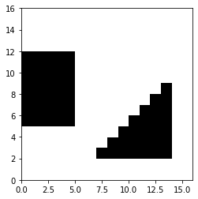
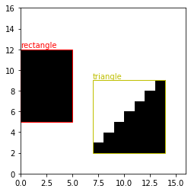
Multiple Object Detection
Input
Image
Output
(bx₁, by₁, bh₁, bw₁, c₁)
(bx₂, by₂, bh₂, bw₂, c₂)
…
Evaluation Metric
Sum of IOUs
Predicted class label of each object

Slide 20
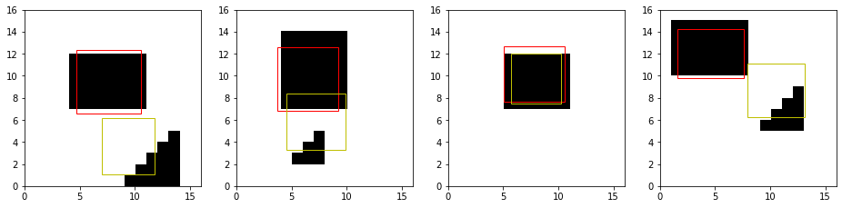
Demo: Multiple Object Detection
Jupyter notebook rectangles_or_triangles.ipynb

Slide 21
Agenda
From Image Classification to Object Localization to Object Detection
A Simple Introduction to Object Detection
State-of-the-Art Object Detection Methods
R-CNN
YOLO
Applications of Object Detection
Summary

Slide 22
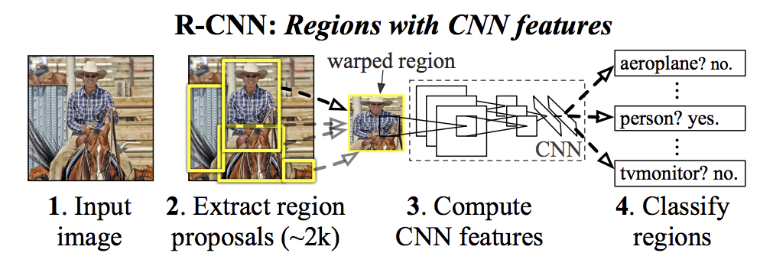
Region-based Convolutional Neural Networks (R-CNN)
Region-based Convolutional Neural Networks (R-CNN)
Module 1: Region Proposal
Generate and extract category independent region proposals, e.g. candidate bounding boxes.
Module 2: Feature Extractor
Extract feature from each candidate region, e.g. using a deep convolutional neural network.
Module 3: Classifier
Classify features as one of the known class, e.g. linear SVM classifier model.
Ross Girshick, Jeff Donahue, Trevor Darrell, Jitendra Malik, “Rich Feature Hierarchies for Accurate Object Detection and Semantic Segmentation”, ICVPR2014.

Slide 23
Main Problem of R-CNN
R-CNN is slow
Training is a multi-stage pipeline.
Involves the preparation and operation of three separate models.
Training is expensive in space and time.
Training a deep CNN on so many region proposals per image is very slow.
Object detection is slow.
Make predictions using a deep CNN on so many region proposals is very slow.

Slide 24
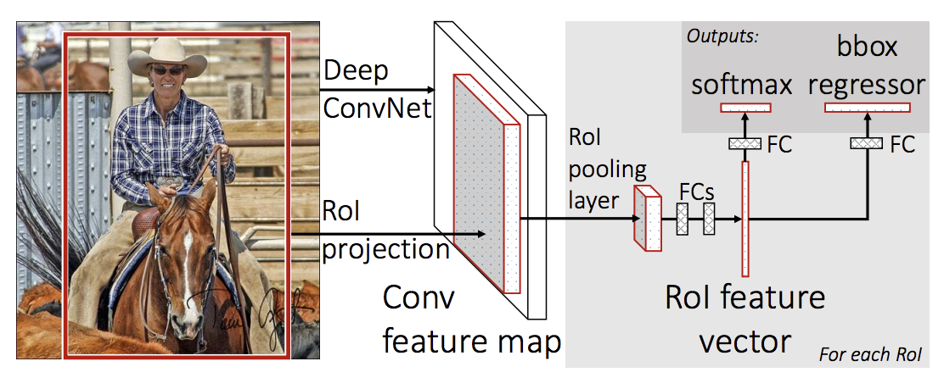
Fast R-CNN
Changes in R-CNN
Use a single model instead of a pipeline
A pre-trained CNN is used for feature extraction
VGG-16
Region of Interest Pooling Layer (Rol Pooling)
Extract features specific for a given input candidate region
Output
Class prediction output + Bounding box output
Ross Girshick, Fast R-CNN, ICCV2015.

Slide 25
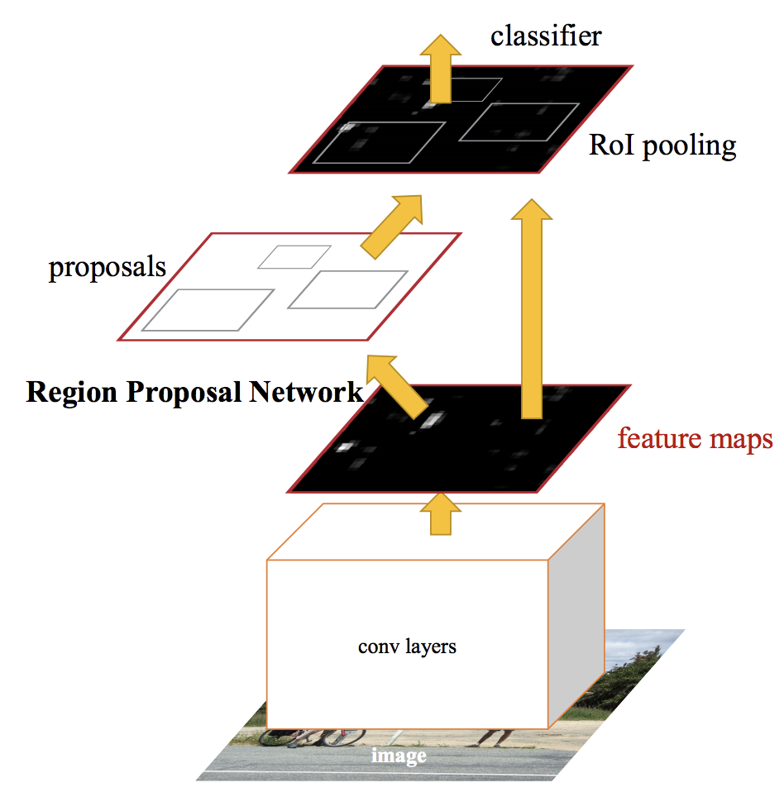
Faster R-CNN
Module 1: Region Proposal Network.
CNN for proposing regions and the type of object to consider in the region.
Module 2: Fast R-CNN.
CNN for extracting features from the proposed regions and outputting the bounding box and class labels.
Shaoqing Ren, Kaiming He, Ross Girshick, Jian Sun, Faster R-CNN: Towards Real-Time Object Detection with Region Proposal Networks, arXiv:1506.01497, 2016.

Slide 26
Agenda
From Image Classification to Object Localization to Object Detection
A Simple Introduction to Object Detection
State-of-the-Art Object Detection Methods
R-CNN
YOLO
Applications of Object Detection
Summary

Slide 27
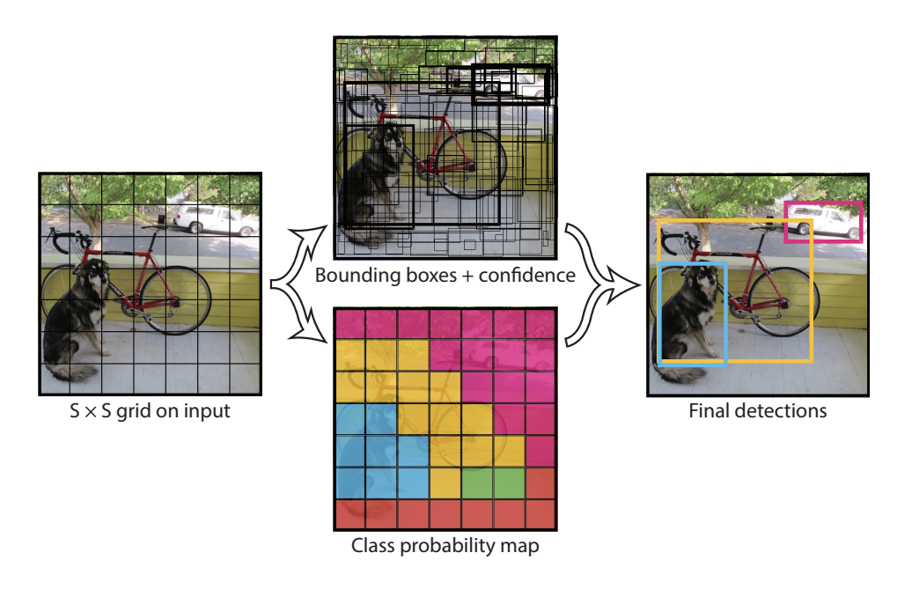
YOLO (You Only Look Once) Model
Cell Grid
Split input image into a grid of cells
Each cell predicts a bounding box if the center of a bounding box falls in it
Each cell also predicts the class probability of its bounding boxes
Combination
Combine class probability map and bounding boxes with confidences
Generate final prediction
Set of bounding boxes
Class labels
Joseph Redmon, Santosh Divvala, Ross Girshick, Ali Farhadi, You Only Look Once: Unified, Real-Time Object Detection, arXiv:1506.02640, 2015.

Slide 28
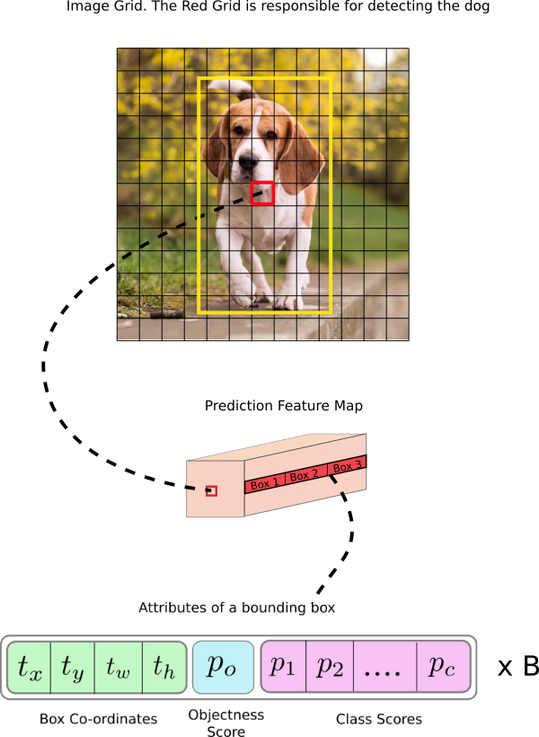
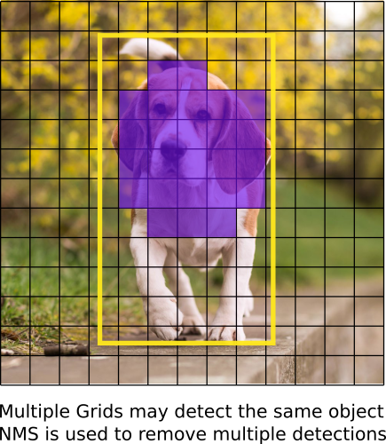
YOLO Prediction
Objectness score measures how well the detector identifies the locations and classes of objects
Image Source: How to implement a YOLO (v3) object detector from scratch in PyTorch

Slide 29
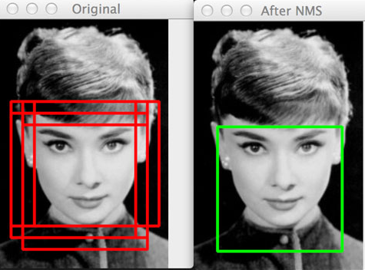
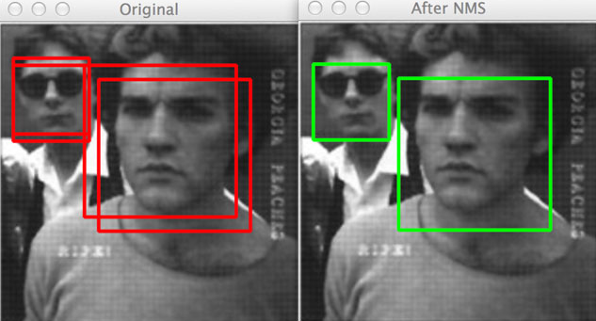
Non-Maximum Suppression
NMS
Select representative bounding boxes
Suppress the others
Criteria
Probability of prediction
IOU
https://www.pyimagesearch.com/2014/11/17/non-maximum-suppression-object-detection-python/

Slide 30
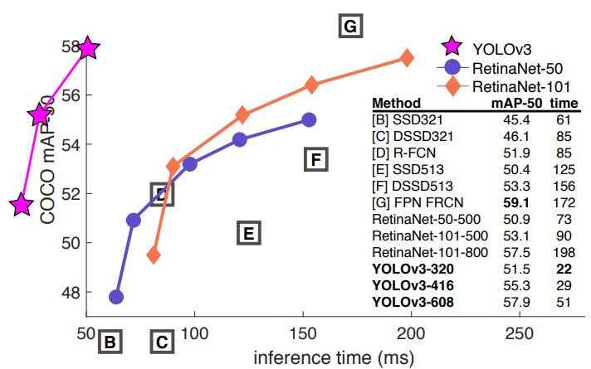
YOLOv2 and YOLOv3
YOLOv2
Anchor boxes
Pre-defined bounding boxes with useful shapes and sizes
Allow changes during training
YOLOv3
Deeper feature detector network
Representation changes
Joseph Redmon, Ali Farhadi, YOLO9000: Better, Faster, Stronger, 2016.
Joseph Redmon, Ali Farhadi, YOLOv3: An Incremental Improvement, 2018.

Slide 31
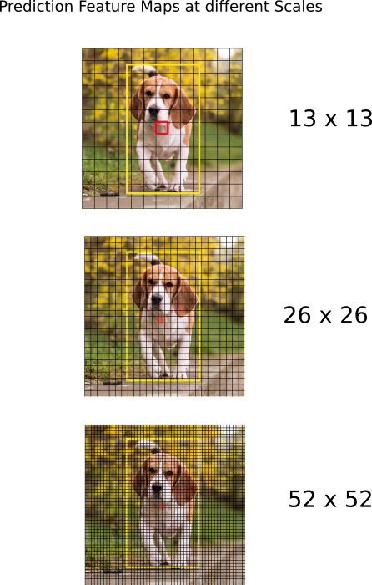
YOLOv3
Prediction across 3 different scales
Better at detecting small objects
Image Source: How to implement a YOLO (v3) object detector from scratch in PyTorch

Slide 32
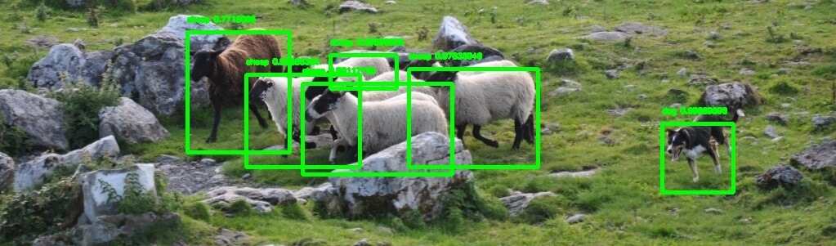
Demo: YOLO Object Detection
Jupyter notebook YOLO3.ipynb

Slide 33
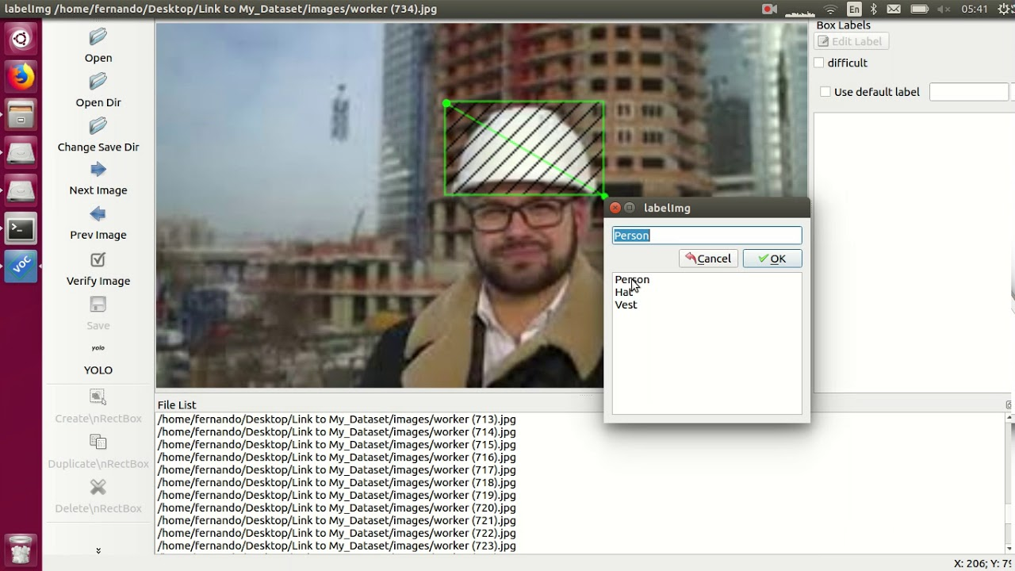
Training YOLO on New Classes
Collect Data and Generate Annotation
Bbox_label_tool

Slide 34
Agenda
From Image Classification to Object Localization to Object Detection
A Simple Introduction to Object Detection
State-of-the-Art Object Detection Methods
R-CNN
YOLO
Applications of Object Detection
Summary

Slide 35
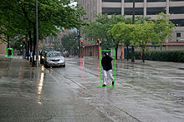
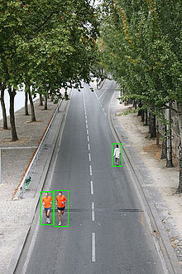
Pedestrian Detection
Intelligent Video Surveillance system
Automotive applications
Advanced driver-assistance systems (ADAS)
Road Safety

Slide 36
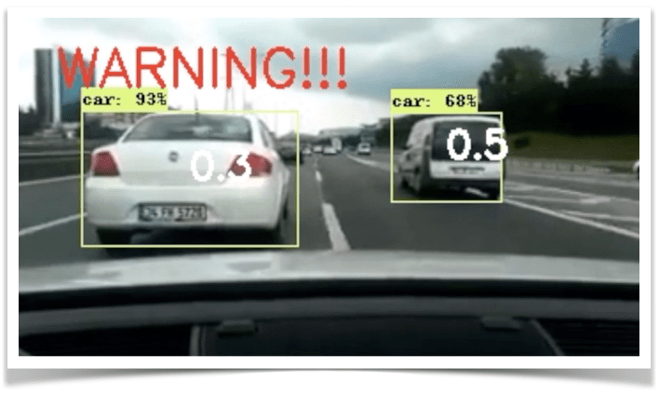
Automatic Driving
Detection of objection on the road

Slide 37
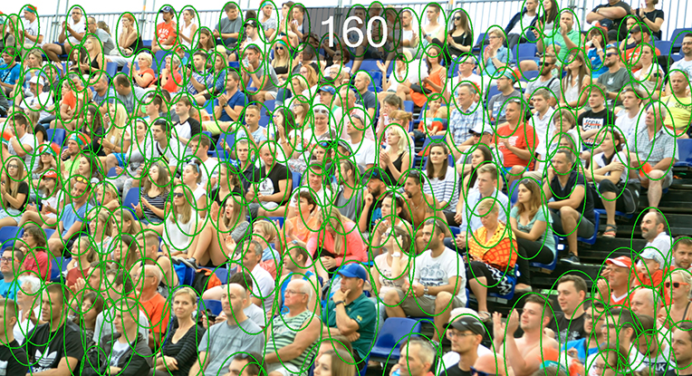
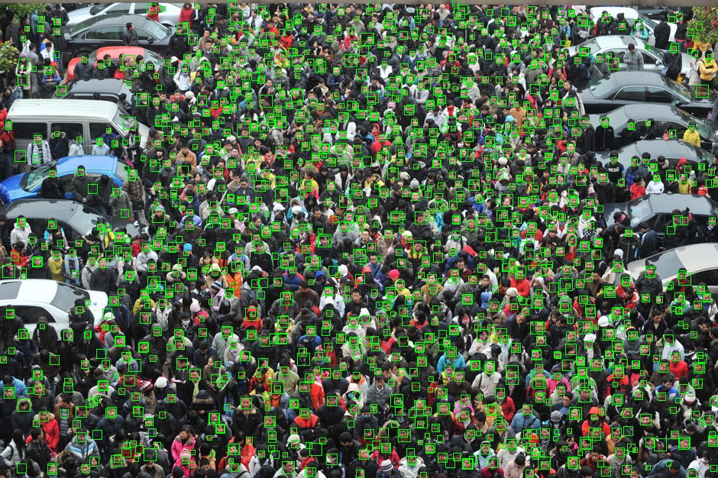
Crowd Counting
Estimate the number of people
Indoor
Outdoor
Event Management
How many people attended an event?
Business Applications
How many potential customers walk through a location at a certain time?
Police
How many protestors?

Slide 38
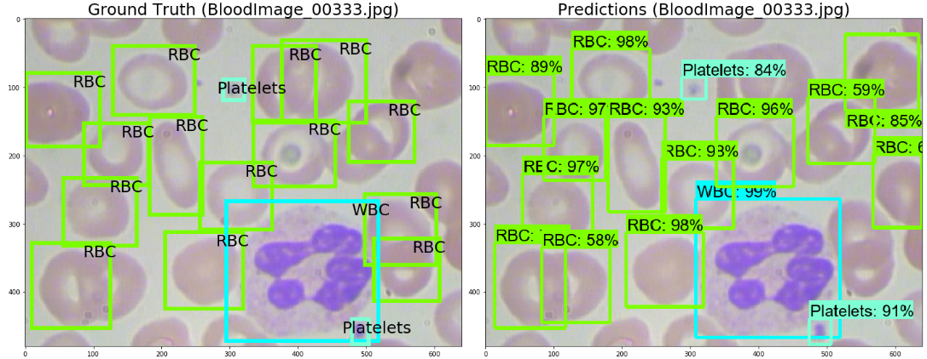
Biomedical Applications
Detection and Classification of Blood Cells

Slide 39
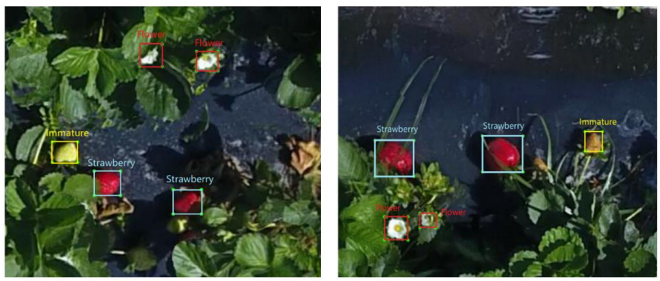
Strawberry Yield Prediction
Accurate yield forecasts for strawberries
Accurately count the number of strawberry flowers
Allocate optimal labor and equipment
Manage resources for harvesting, transportation, and marketing
Yang Chen, Won Suk Lee, Hao Gan, Natalia Peres, Clyde Fraisse, Yanchao Zhang and Yong He, Strawberry Yield Prediction Based on a Deep Neural Network Using High-Resolution Aerial Orthoimages, Remote Sensing, 2019.

Slide 40
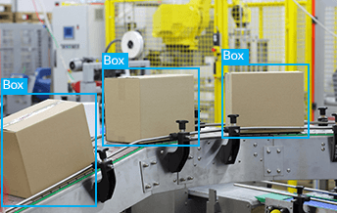
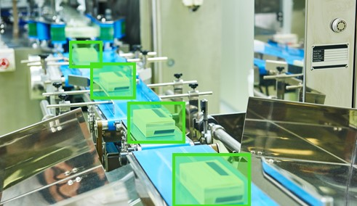
Manufacturing
Quality Control
Maintenance
Packing and Shipping
Logistics Management
Inventory Management
Component Assembly

Slide 41
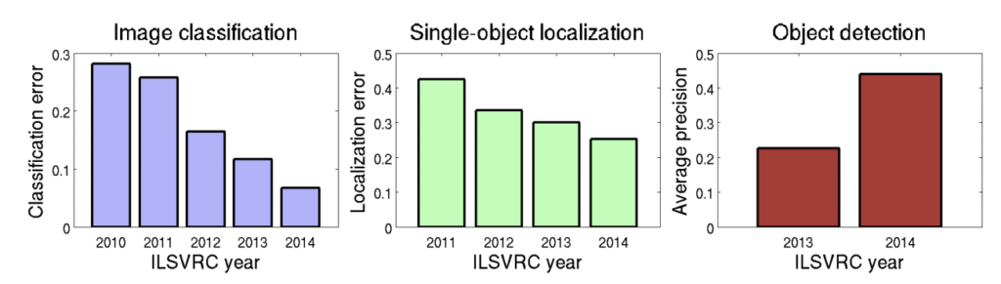
Summary
Techniques of Object Detection
State-of-the-Art
Applications

